Slide 1
Microsoft Azure Machine Learning

Slide 2

Cloud Computing
What is cloud
Cloud computing is the delivery of computing services—servers, storage, databases,
networking, software, analytics and more—over the Internet (“the cloud”).
Companies offering these computing services are called cloud providers and
typically charge for cloud computing services based on usage.
Here are 6 common reasons organizations are turning to cloud computing services:
Cost , Speed , Global scale , Productivity, Performance and Reliability
Types of cloud service models
IaaS – Infrastructure as a Service ex; Virtual Machines/ Servers/ Network/ Load Balancer/Storage …
PaaS – Platform as a Service ex; Execution runtime/ web server/ database …
SaaS – Software as a Service ex; Software services, Desktop applications like Adobe CC …

Slide 3
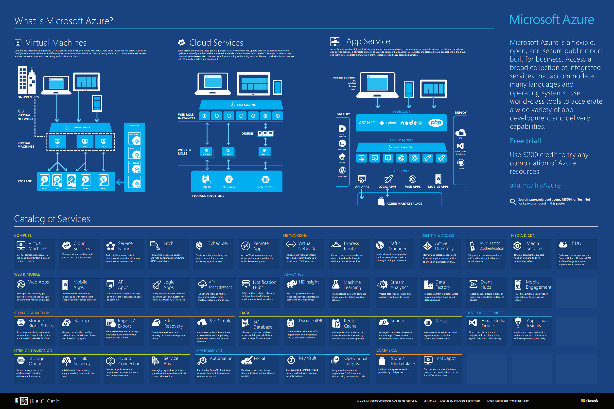

Slide 4
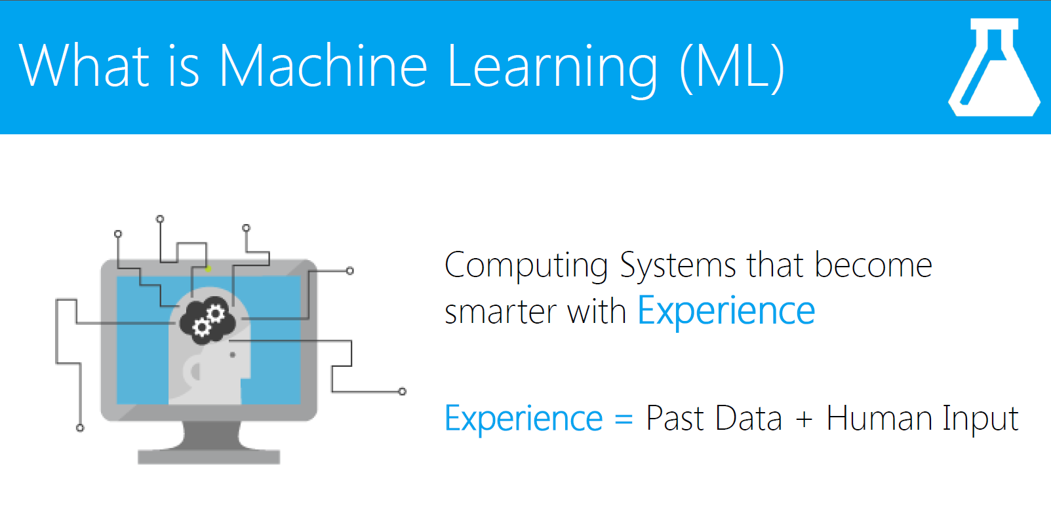
Arthur Samuel's definition from 1959: Machine Learning: Field of study that gives computers the ability to learn without being explicitly programmed.

Slide 5
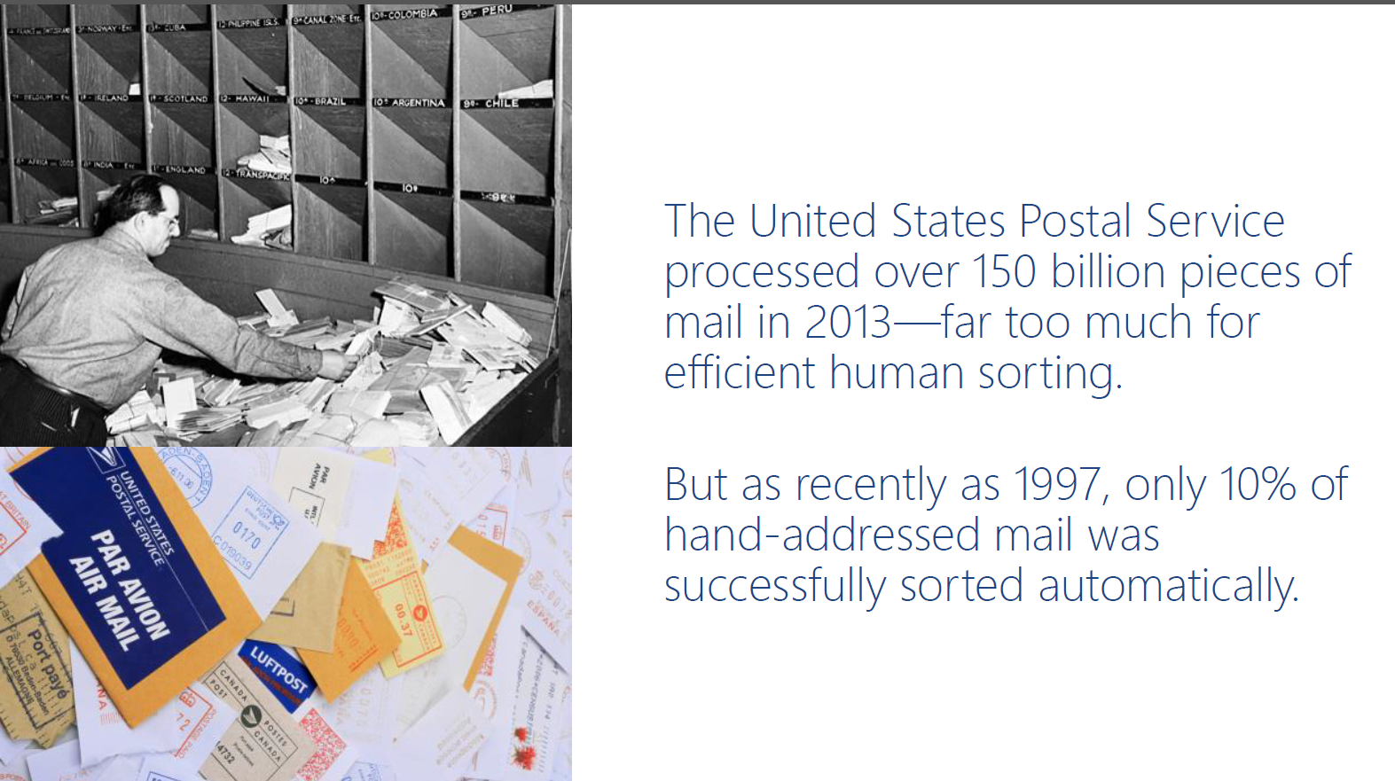

Slide 6
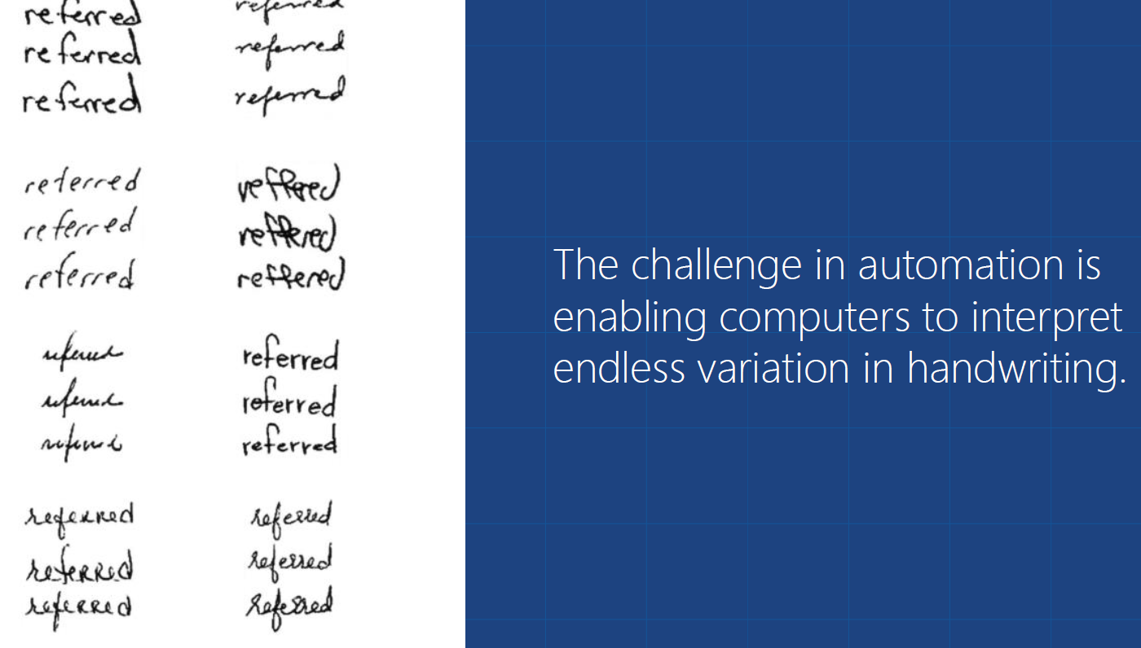

Slide 7
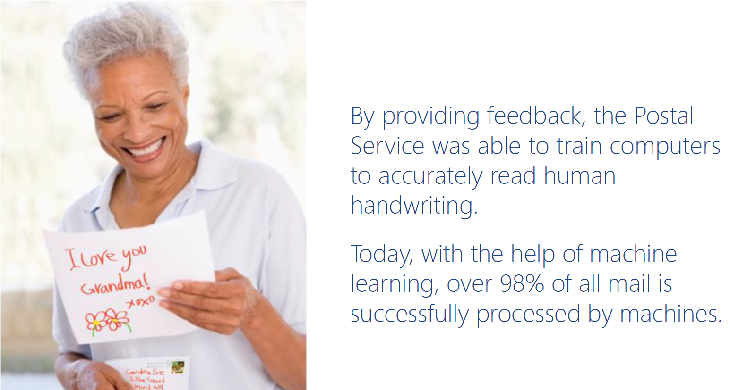

Slide 8
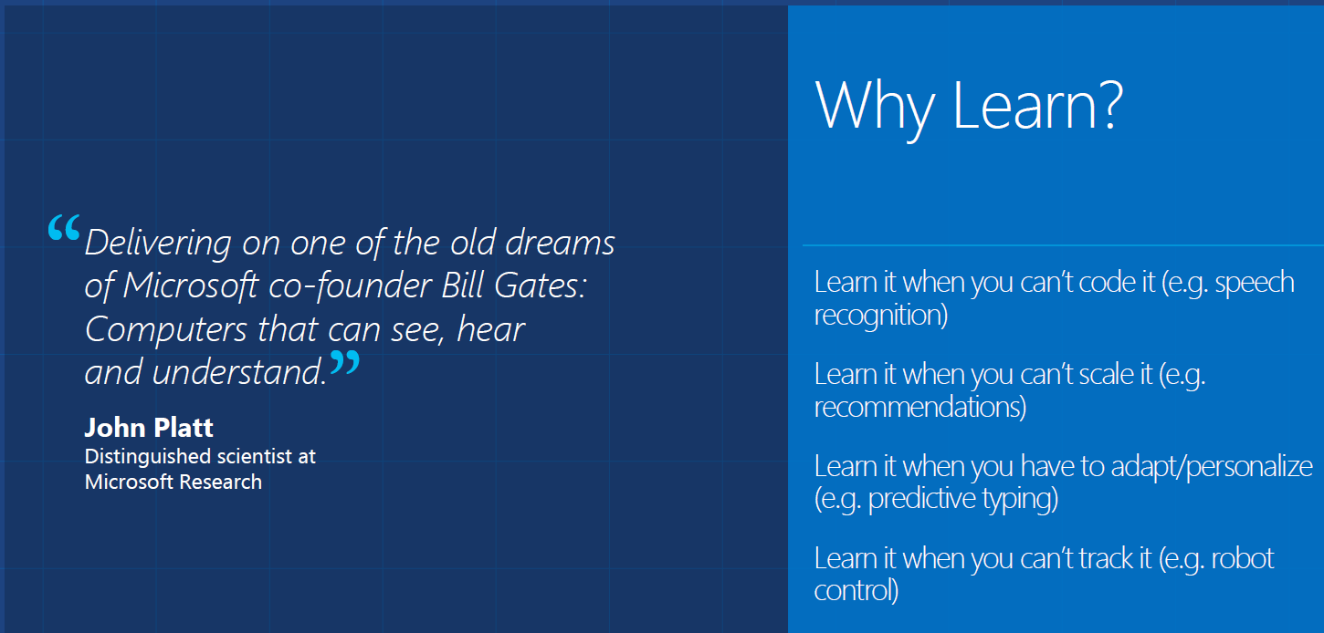

Slide 9
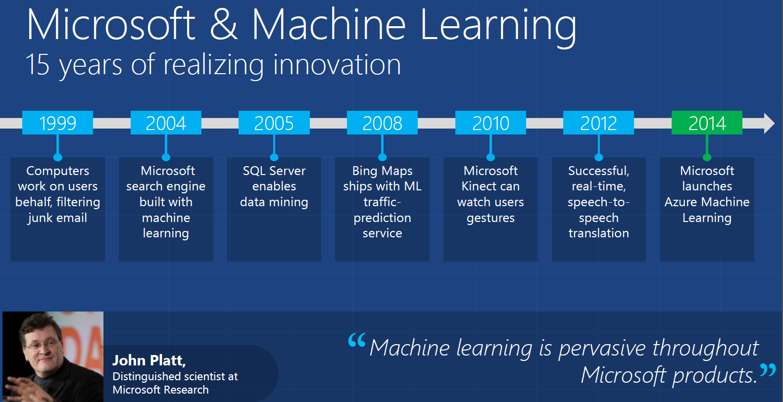

Slide 10
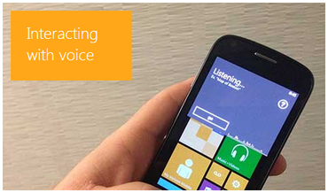
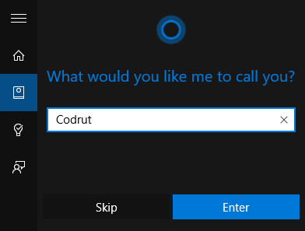

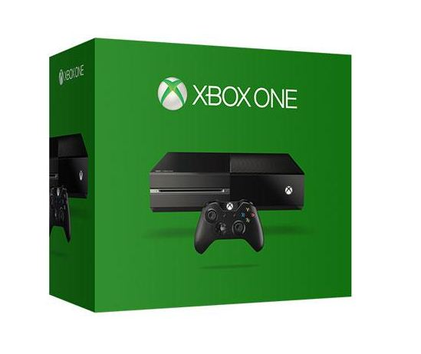

Microsoft Speech Recognition Control
Microsoft Search Engine
Microsoft Xbox and Kinect

Slide 11

I believe over the next decade computing will become even more ubiquitous and intelligence will become ambient… this will be made possible by an ever growing network of connected devices, incredible computing capacity from the cloud, insights from big data, and intelligence from machine learning.

Slide 12

“If you invent a breakthrough in Artificial Intelligence, so machines can learn, that is worth 10 Microsoft”

Slide 13
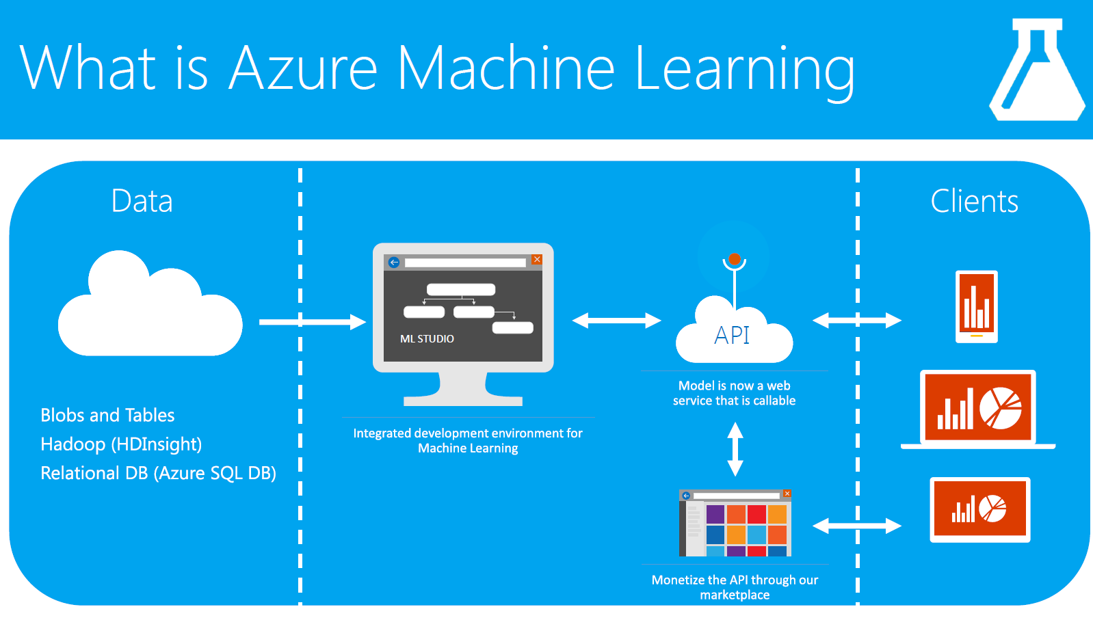

Slide 14


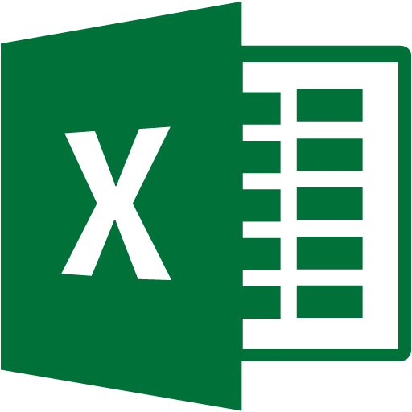



Azure Machine Learning. Overview
Data
Azure Machine Learning
Consumers
Data
Model
ML Web Services
(REST API Services)
API
ML Studio
(Web IDE)
Cloud storage
Azure Storage
Azure Table
Hive
etc.
Excel
Manage
Workspace:
Experiments
Datasets
Trained models
Notebooks
Access settings
Azure Marketplace
(Applications store)
API
Local storage
Upload data from PC…
Azure ML Gallery
(community)
Business Apps
Business problem
Modeling
Deployment
Business value
Reference: TechEd 2014 Conference

Slide 15
Azure Machine Learning. Overview
Data Science is far too complex today
Math
Computer Science
Domain
Reduce complexity to broaden participation
No software to install, only web browser;
Possibility to develop without writing line of code;
Easy deployment and usage using restfull API;
Easy collaboration on Azure ML projects;
Visual composition with end2end support for Data Science workflow;
Extensible, support for R .
Guiding Principles
Reference: TechEd 2014 Conference

Slide 16
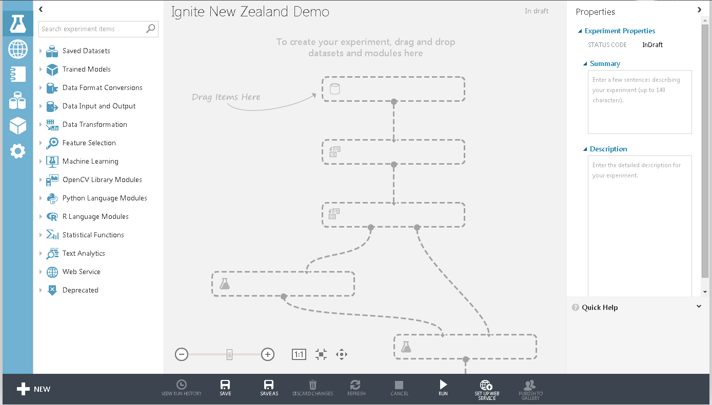
Microsoft Azure Machine Learning
Reduced Complexity
Access Through Web Browser, no need to install any thing
Collaborate work with anyone
Visual composition, easy to use, No Coding
Good storage of Algorithm (Use in Bing search, Xbox..)
Have good support for R studio, Python and Jupyter notebook
Load Data From Different Location
Clean data
Machine
Learning
Algorithms
R and
Python Language
Web services

Slide 17
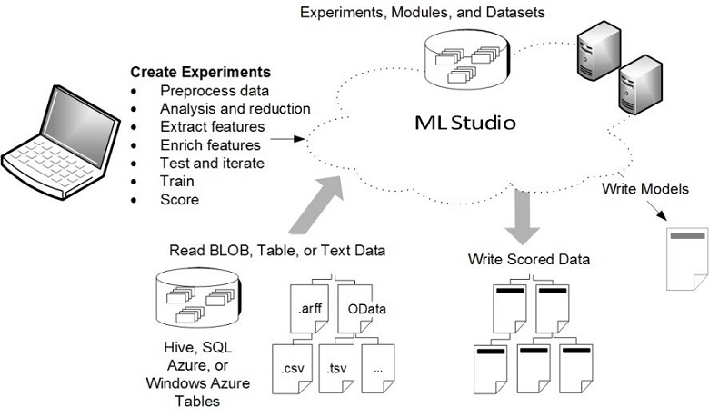
Azure Machine Learning Studio

Slide 18
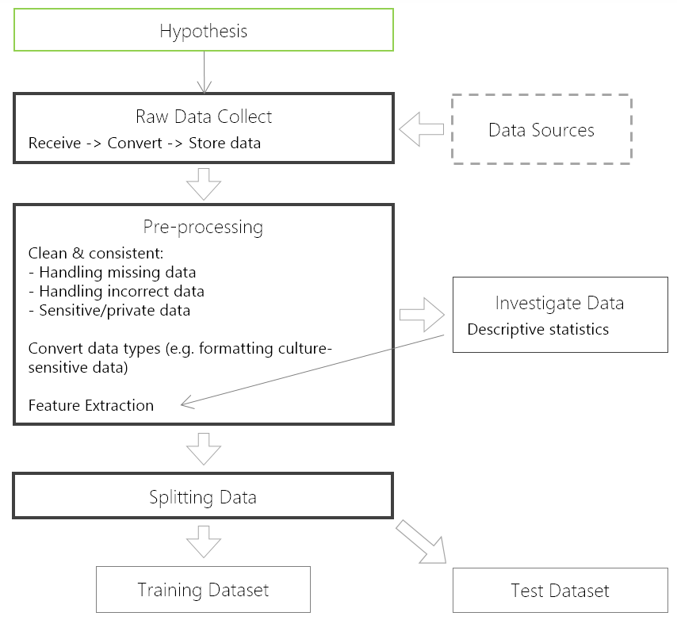
Supervised Learning Flow Part #1
Azure Machine Learning. Azure ML Flow
Notes:
Feature extraction - process attempts to create additional relevant features from the existing raw features in the data, and to increase predictive power to the learning algorithm

Slide 19
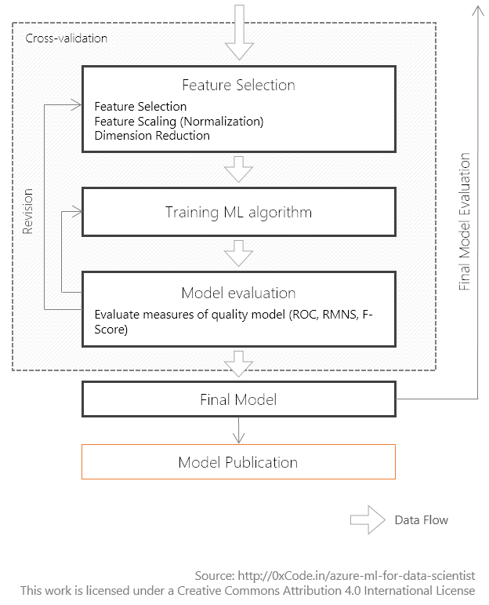
Supervised Learning Flow Part #2
Azure Machine Learning. Azure ML Flow
Source
Notes:
Feature selection often increases classification accuracy by eliminating irrelevant, redundant, or highly correlated features.
Second, it decreases the number of features which makes model training process more efficient – compute and algorithm performance.
This is particularly important for learners that are expensive to train such as support vector machines.
Process selects the key subset of original data features in an attempt to reduce the dimensionality of the training problem.
PCA & ICA
LDA, Fisher
root mean square error (RMSE)

Slide 20
Azure Machine Learning Studio

Slide 21
Data Science - The 5 questions data science answers
Question 1: Is this A or B? uses classification algorithms
Question 2: Is this weird? uses anomaly detection algorithms
Question 3: How much? or How many? uses regression algorithms
Question 4: How is this organized? uses clustering algorithms
Question 5: What should I do now? uses reinforcement learning algorithms

Slide 22



Match Data Type
Customer Preferences
Classification
Algorithm
Discrete
Variables
Marital Status
Married, Divorce, Single
Income
More than 50K or
Less Than 50K
Regression Algorithm
Continues
Variables
Income, Sales, Profit

Slide 23
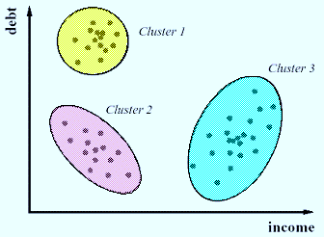
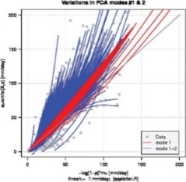
Descriptive and Predictive Analysis
Clustering Algorithm
1-Which other customers have similar preferences to this one?
2-What are the most common patterns in gasoline price changes?
Descriptive
Analysis
Regression Algorithm
Predictive
Analysis
1-When will this customer make another purchase?
2-How many new followers will I get next week?
Classification
Algorithm
1-Will this customer click on the top link?
2-Which offer should this customer receive?
Predictive
Analysis

Slide 24
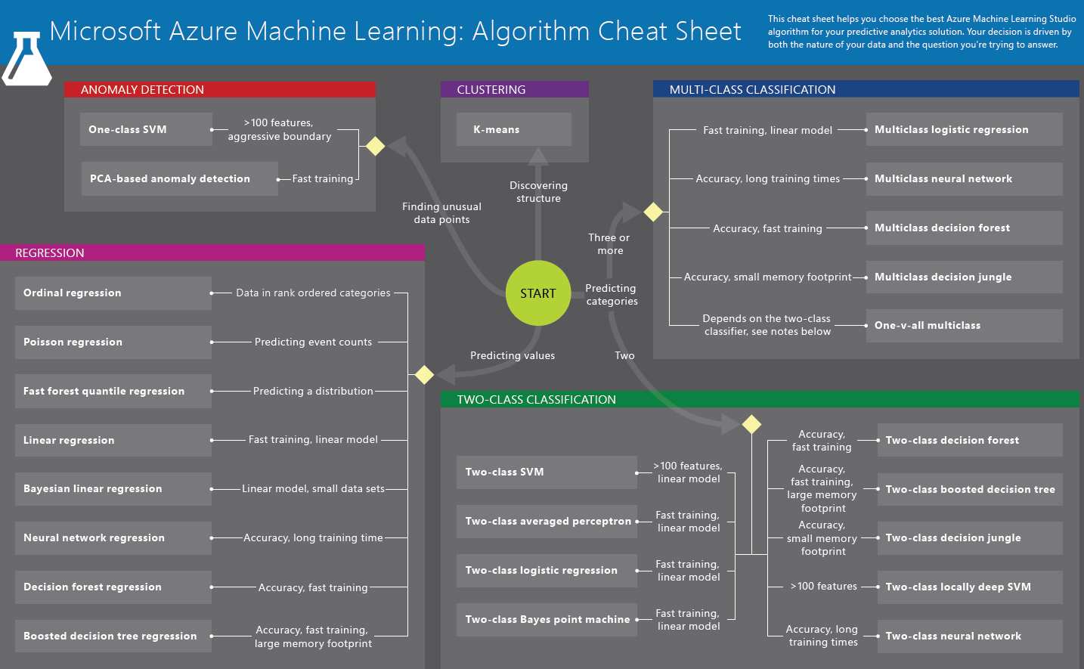
Microsoft Azure Machine Learning: Algorithm Cheat Sheet

Slide 25
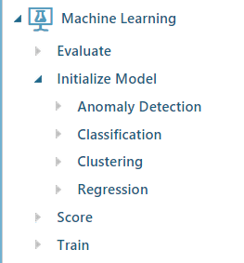
Azure ML Algorithm

Slide 26
Azure Machine Learning web services
Machine Learning web services provide an interface between an application and a Machine Learning workflow scoring model.
Azure Machine Learning has two types of web services:
Request-Response Service (RRS)
Batch Execution Service (BES)

Slide 27


Demo in Azure ML
Automobile – Regression Algorithm
Price prediction

Slide 28
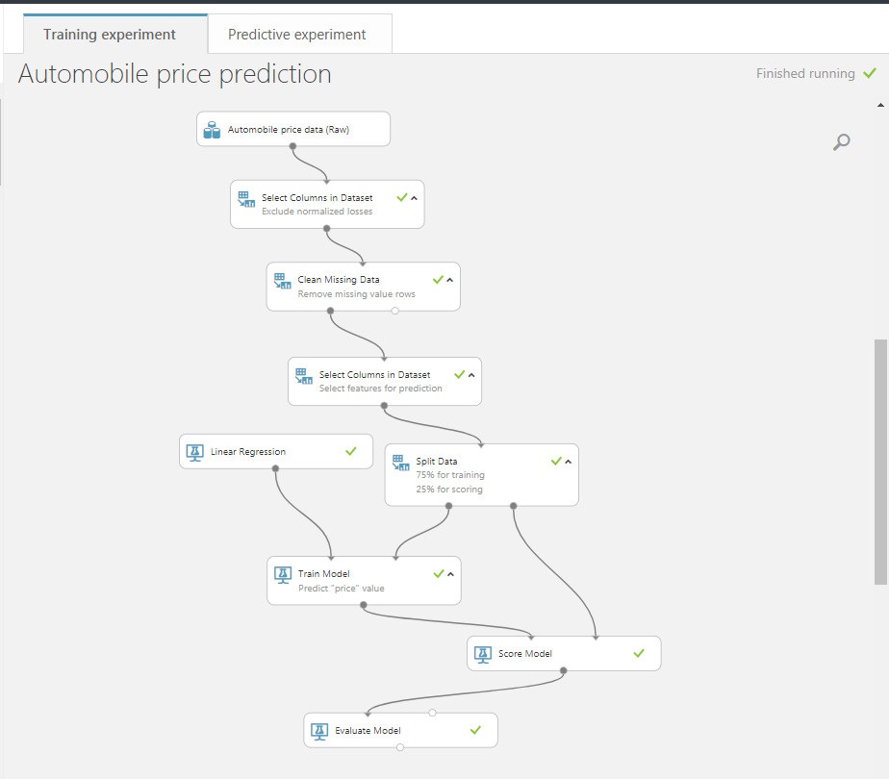

Slide 29
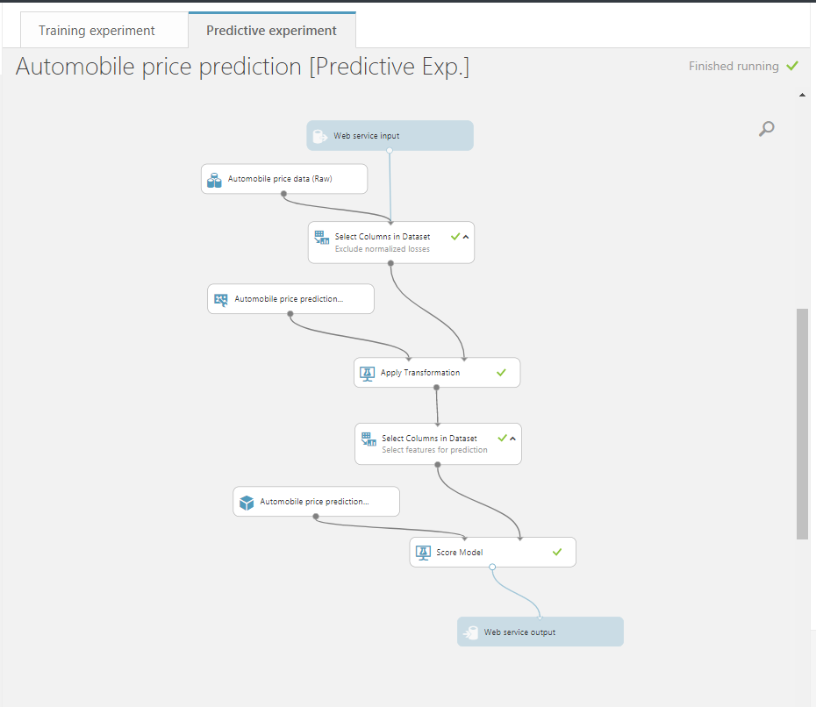

Slide 30


Demo in Azure ML
Titanic –Classification Algorithm
Survived or Not
Titanic sank on15 April 1912 after colliding with an iceberg

Slide 31
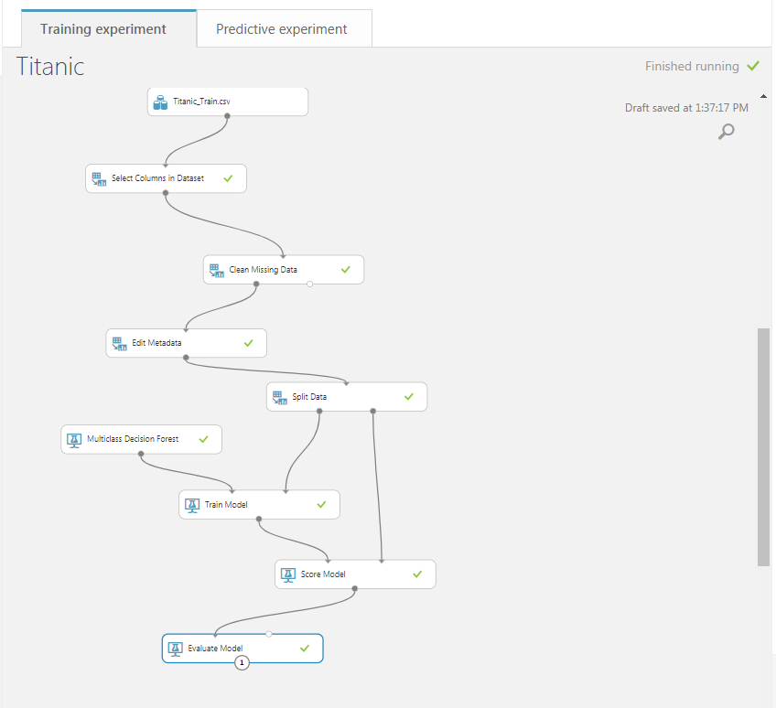

Slide 32
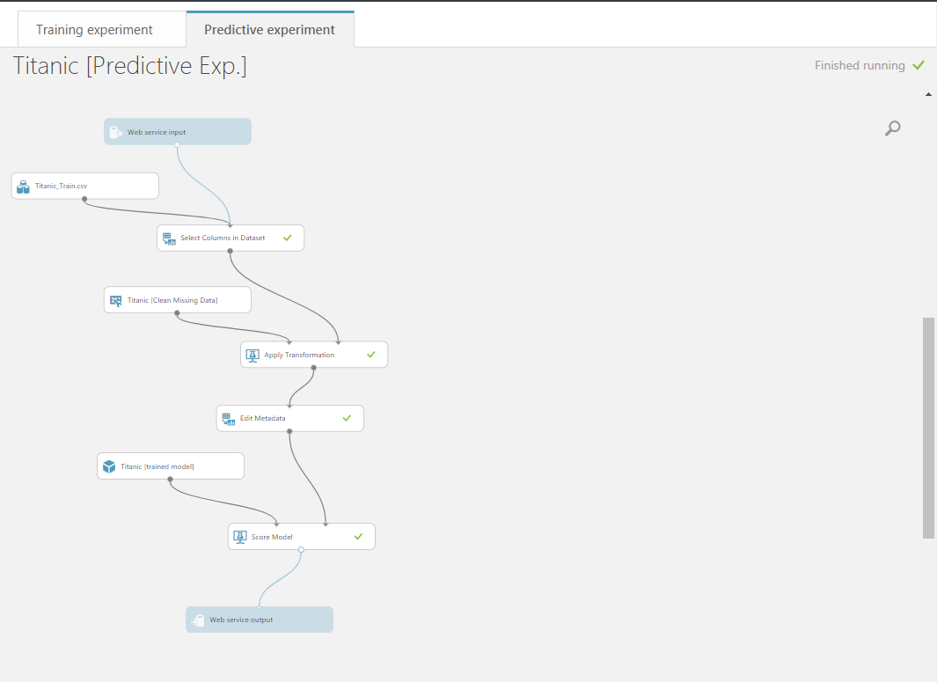

Slide 33
Microsoft Azure API

Slide 34
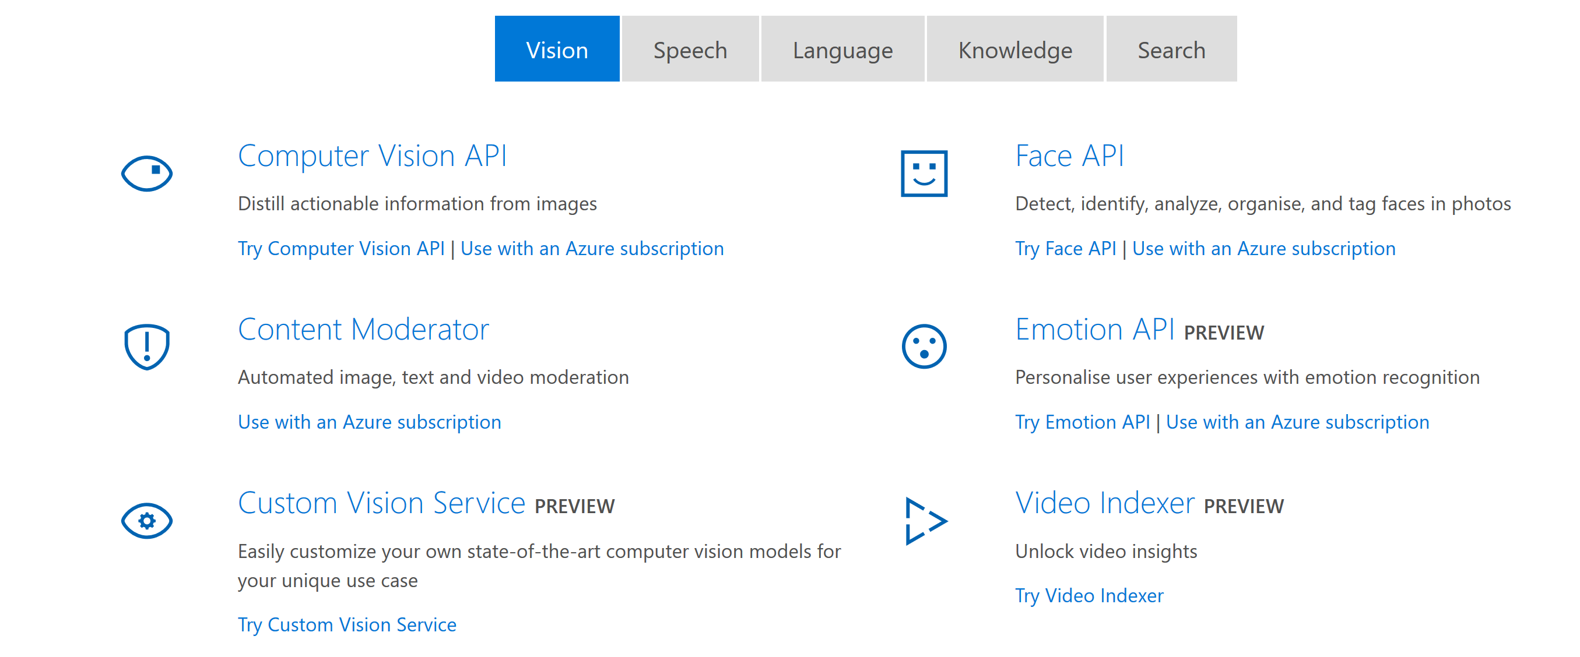

Slide 35
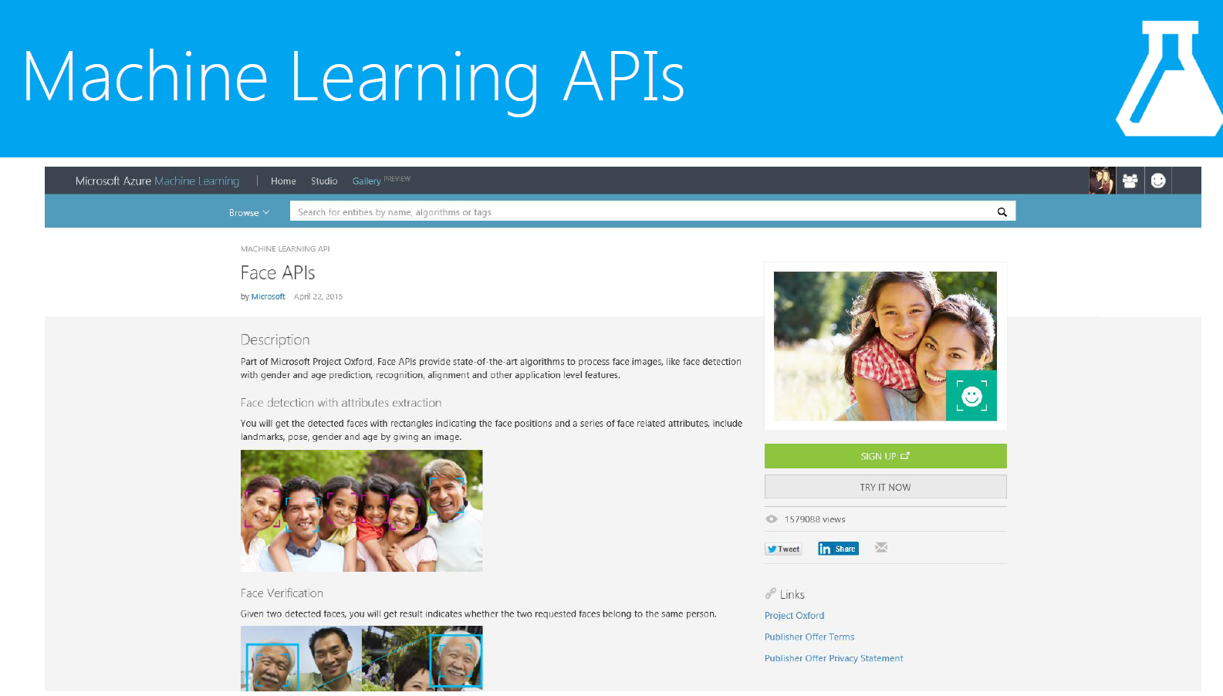
Notes:
https://azure.microsoft.com/en-in/services/cognitive-services/face/
https://azure.microsoft.com/en-in/services/cognitive-services/emotion/

Slide 36
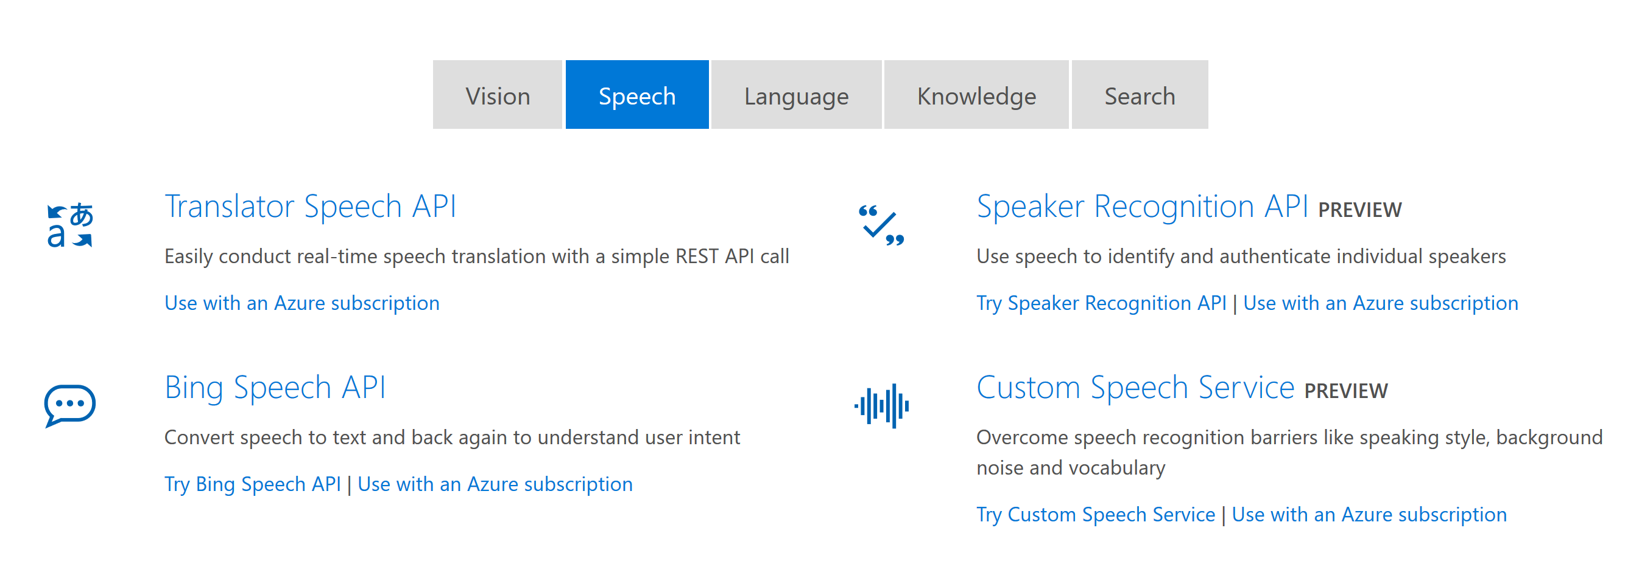

Slide 37
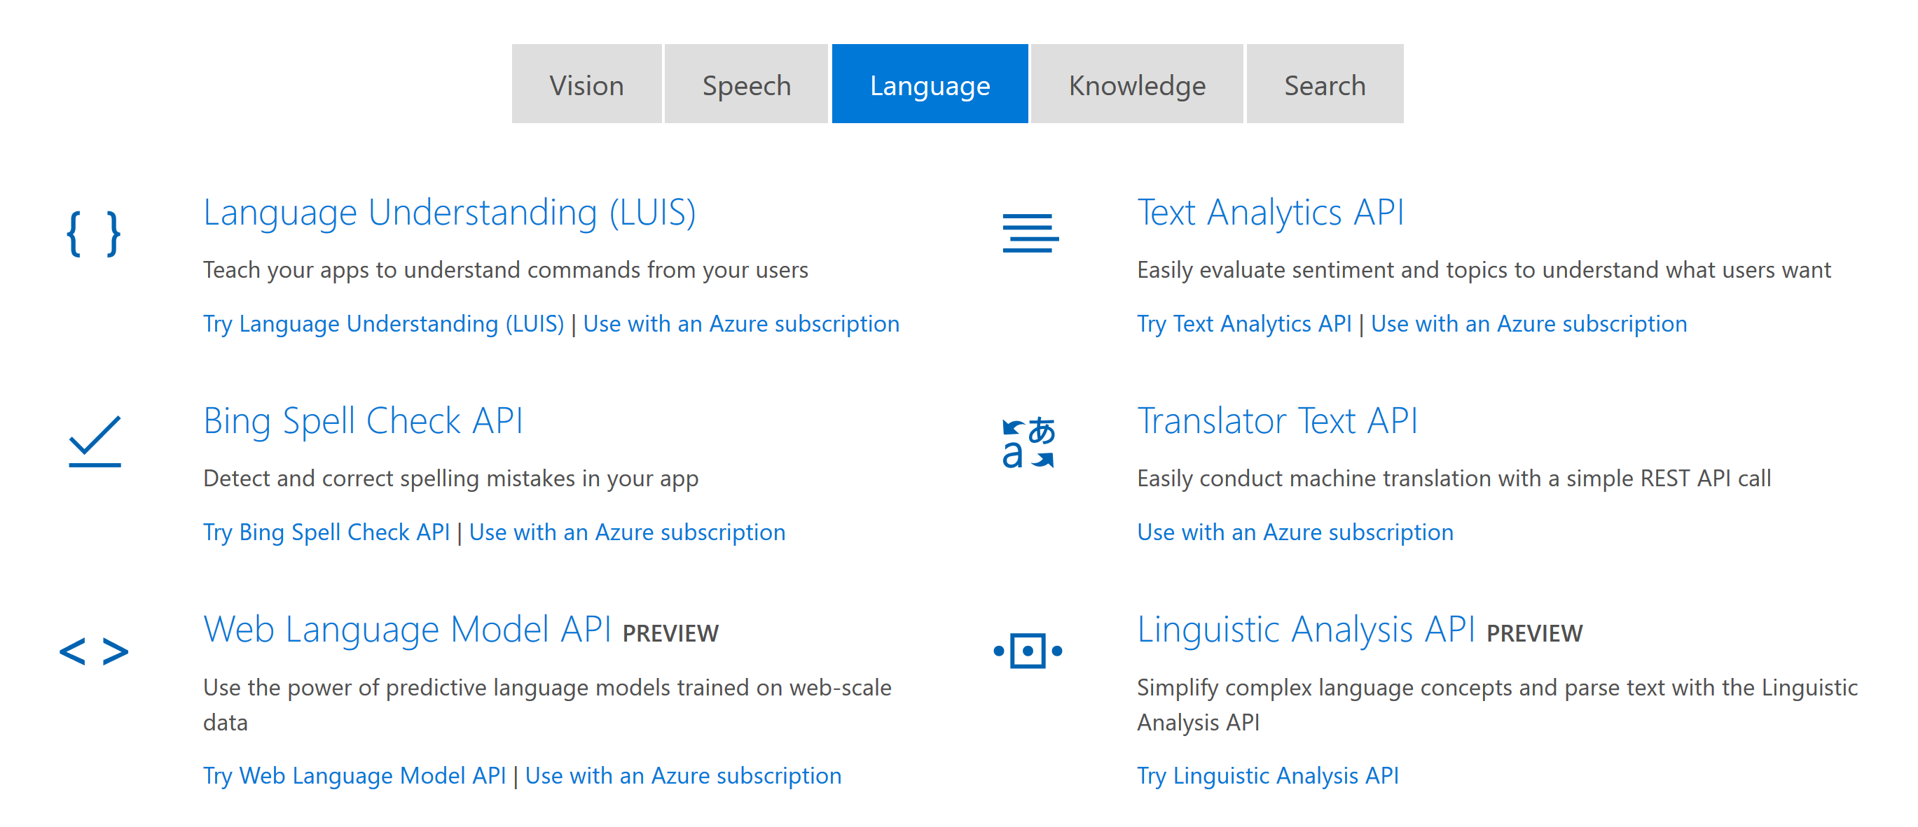

Slide 38
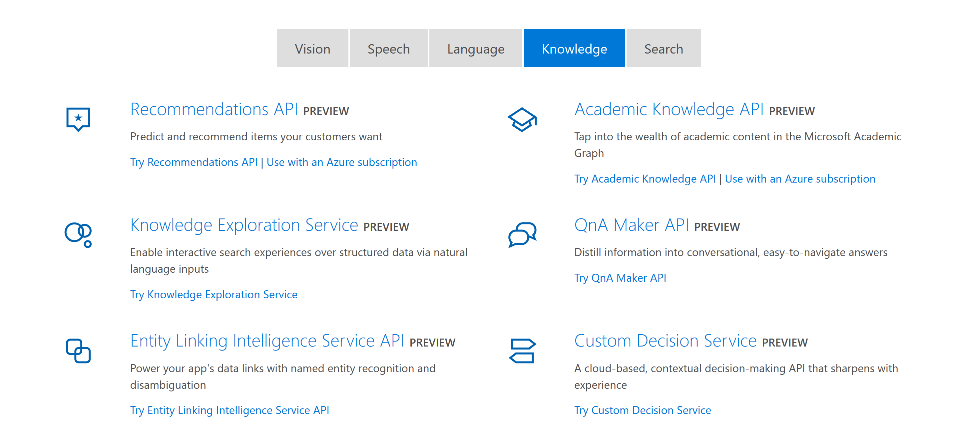

Slide 39
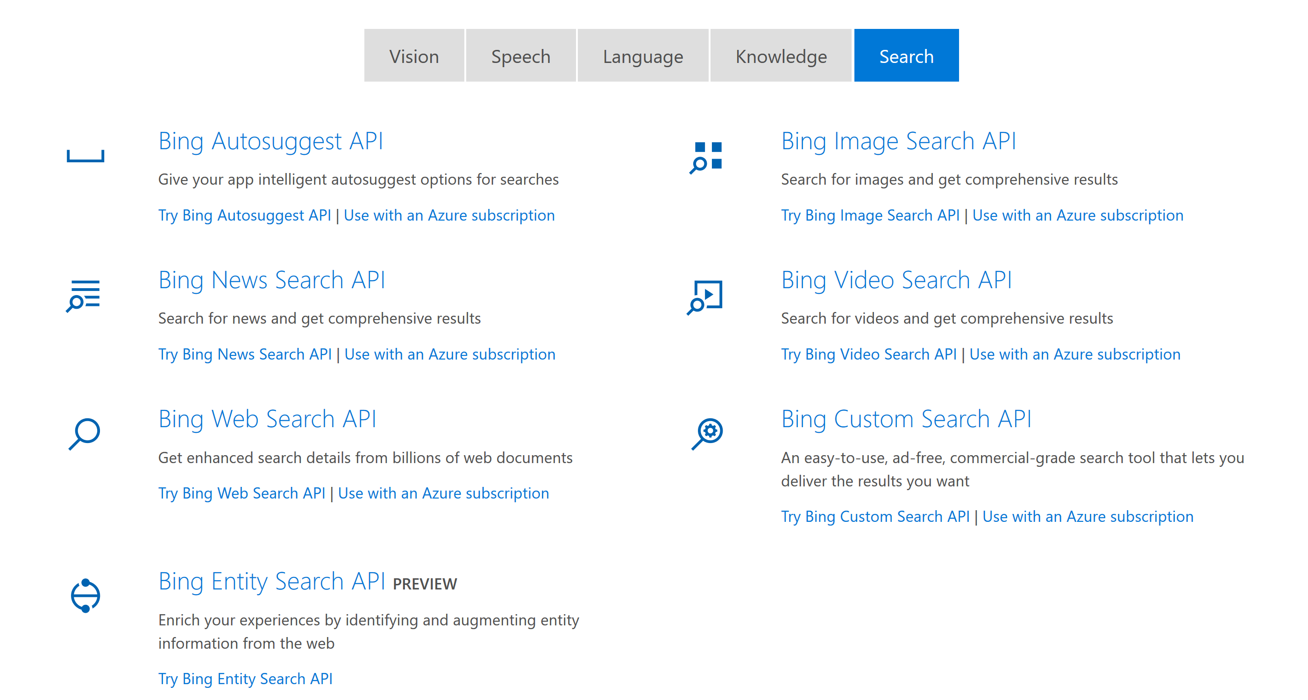

Slide 40
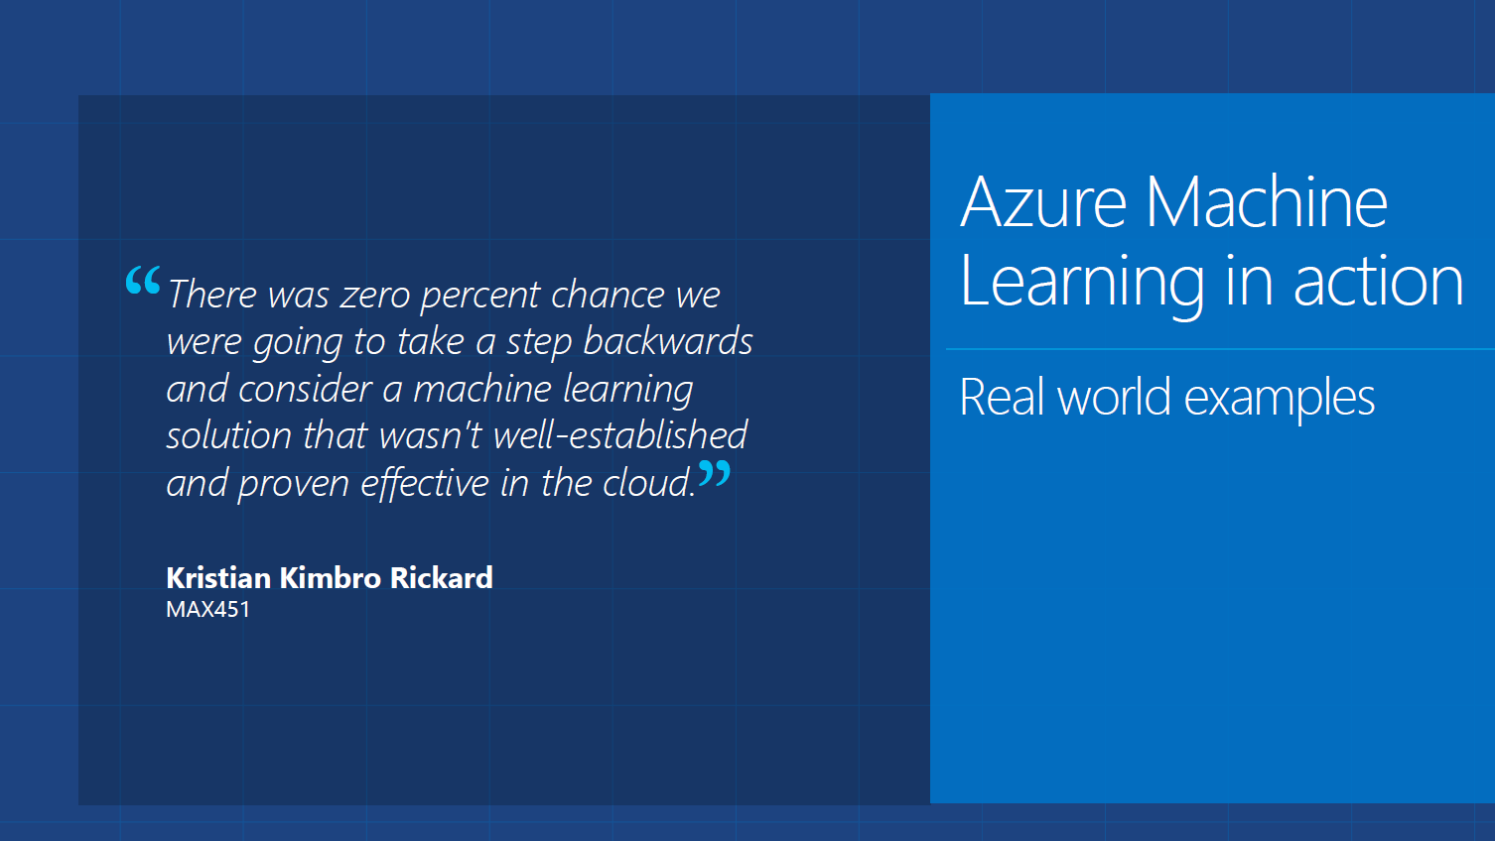

Slide 41

How Hershey’s used MS Azure ML
The Candy Cloud: Microsoft Azure Is Sweet for Hershey
Business Problem - The Pennsylvania-based maker of Twizzlers licorice was struggling to produce a consistent flow of red candy as it poured from a giant vat through an extruder (where it would eventually be cut into its spiral design). If the machine ran too cold, then not enough licorice was produced. If the machine ran too hot, then too much licorice was produced. When too much licorice was produced, Hershey had to give that candy away at a loss
The company implemented Microsoft Azure to calculate, measure, and monitor the temperature of the extruder.
Hershey wanted to predict what the weight of the licorice was going to be without having to stop the machine and weigh it. By using sensors built into the extruder, which fed data back to Microsoft Azure, Hershey was able to monitor exactly how long it took for the machine to cool down to an exact temperature—and how long it took for the machine to heat up again.
Once the standard deviation had been assessed, and solid predictions for when the machine would exceed satisfactory highs and lows had been made, Hershey programmed Microsoft Azure to control the extruder directly. Using Microsoft Azure's machine learning (ML) algorithms, which gave the manufacturing equipment autonomous control over raising and lowering the machine's temperature, the extruder was adjusted 240 times a day—without the help of a human operator.
After the Microsoft Azure implementation, Hershey lowered unwanted extrusions from 100 grams per minute to about 25 grams per minute. Plus, the overall minutes were dramatically reduced.
There are 22 sensors on each Twizzler holding tank, with 60 million data points collected.
Its able to save $500K for every 1% of improved efficiency in making Twizzlers
http://in.pcmag.com/feature/114228/the-candy-cloud-microsoft-azure-is-sweet-for-hershey
All this is done without hiring a data scientist

Slide 42
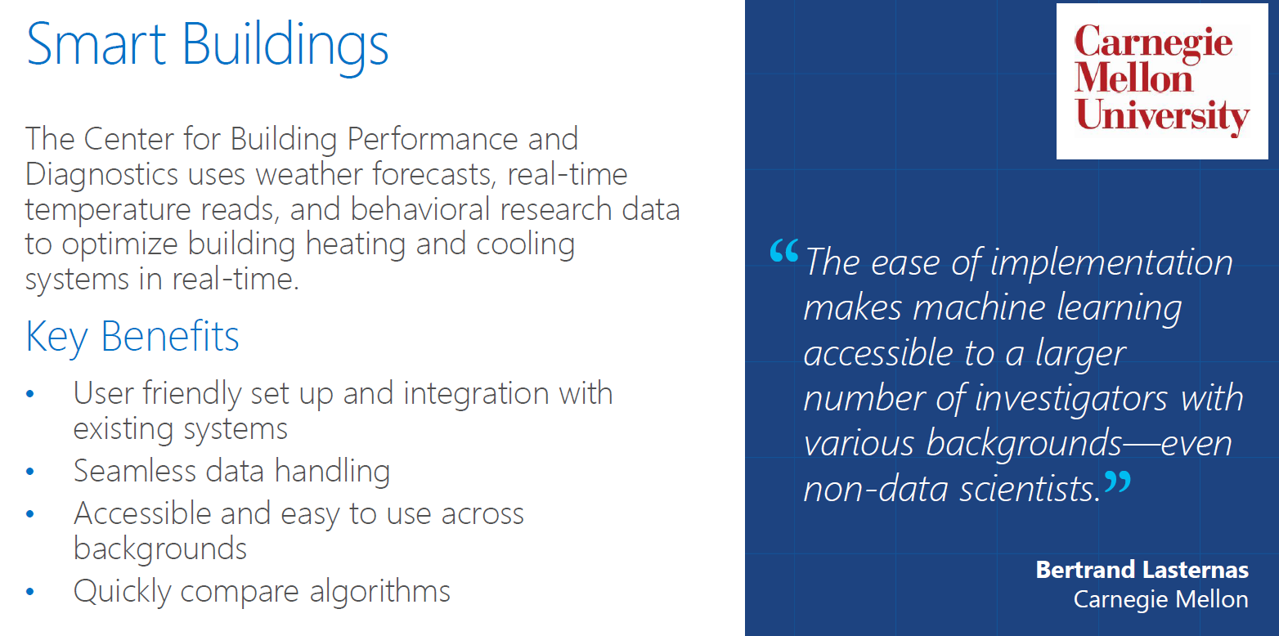

Slide 43
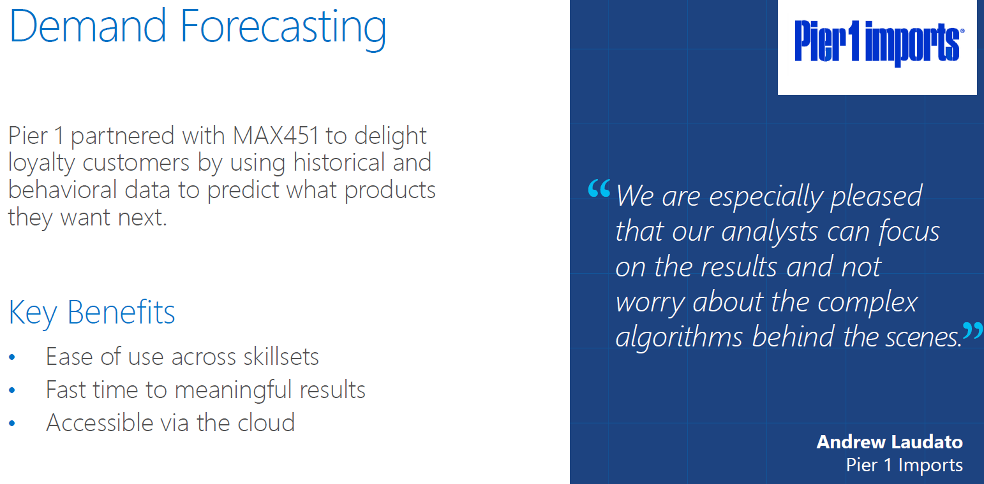

Slide 44
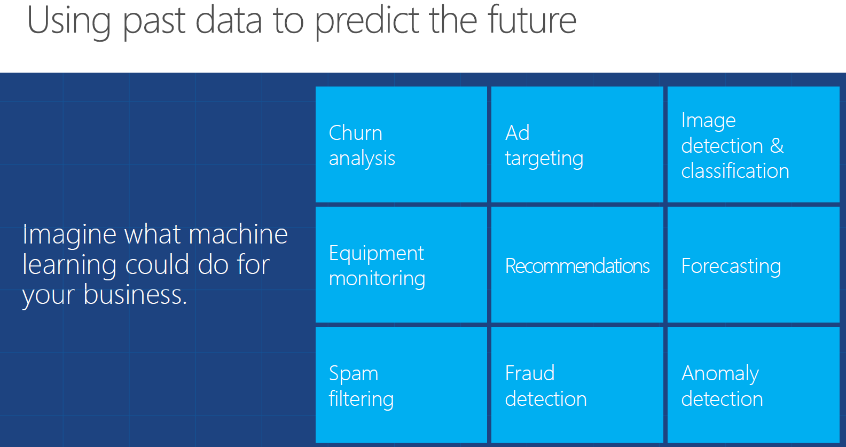

Slide 45
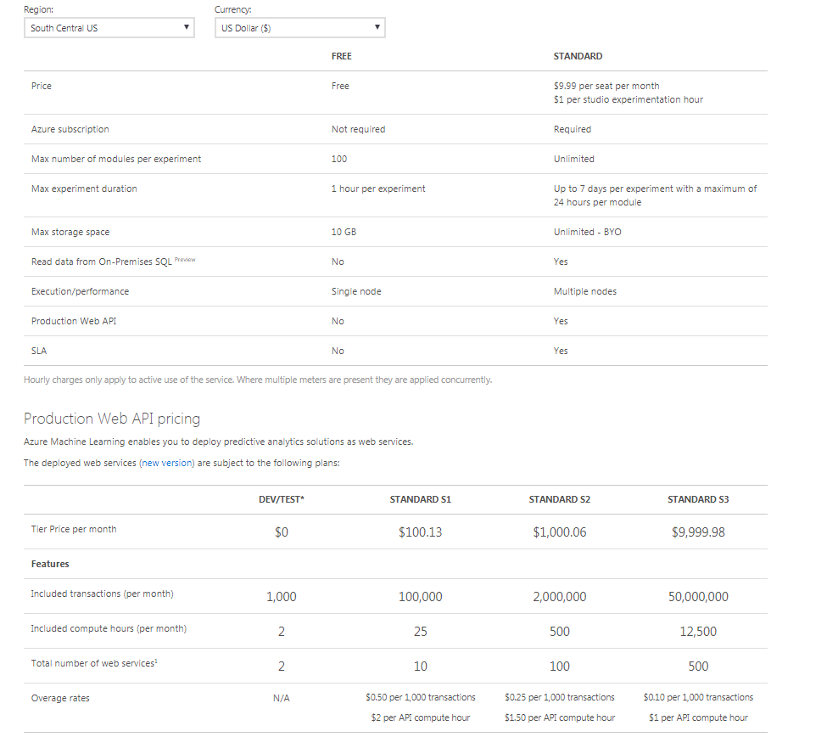
Azure ML Pricing
Notes:
https://azure.microsoft.com/en-us/pricing/details/machine-learning-studio/

Slide 46
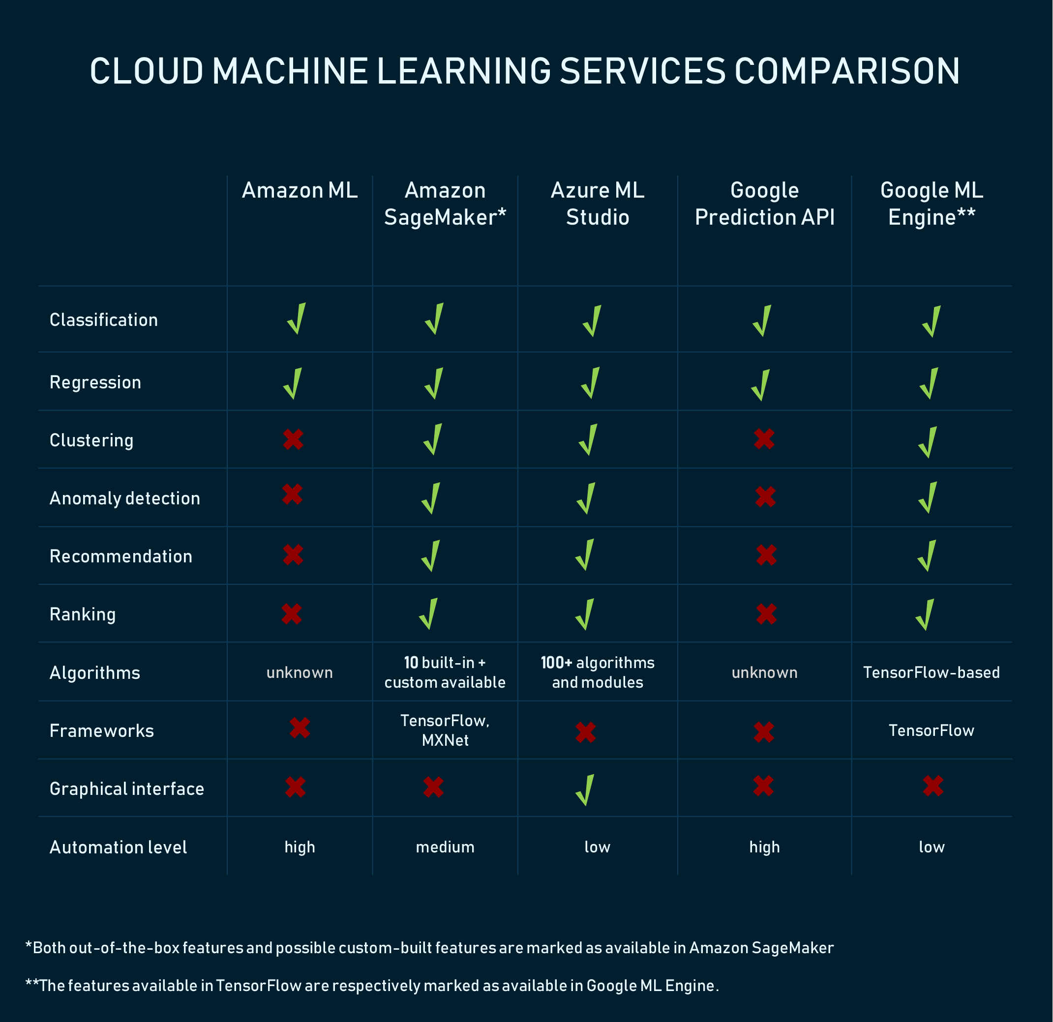
Comparing Azure ML with other ML Services

Slide 47
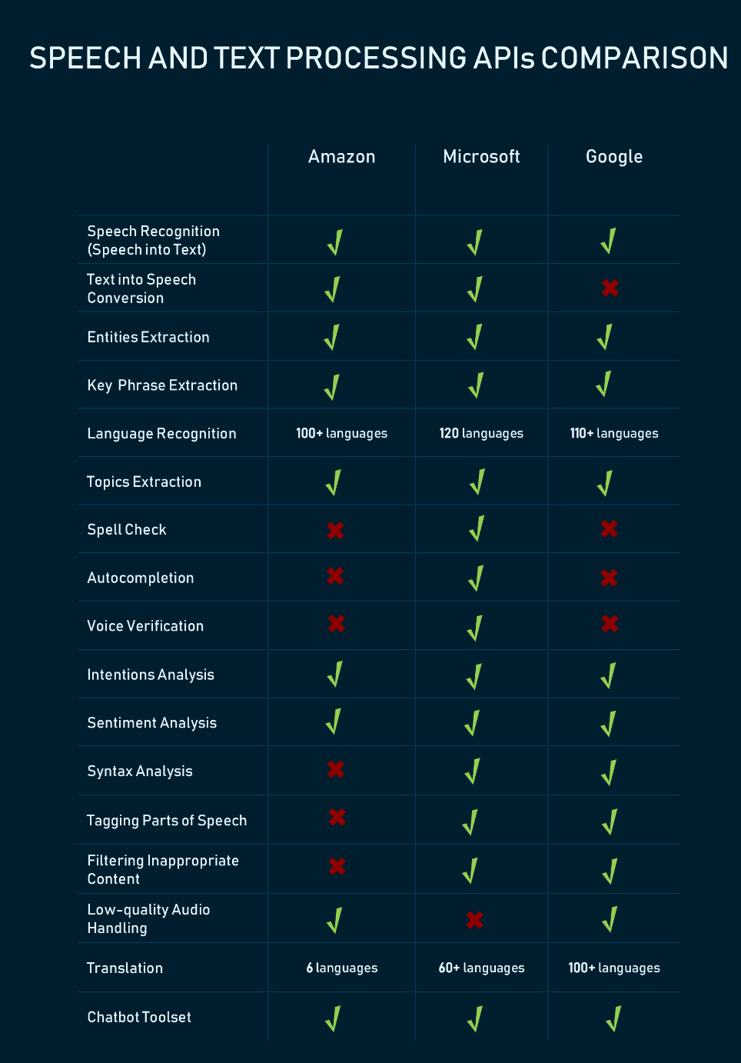
Comparing Azure ML with other MLaS

Slide 48
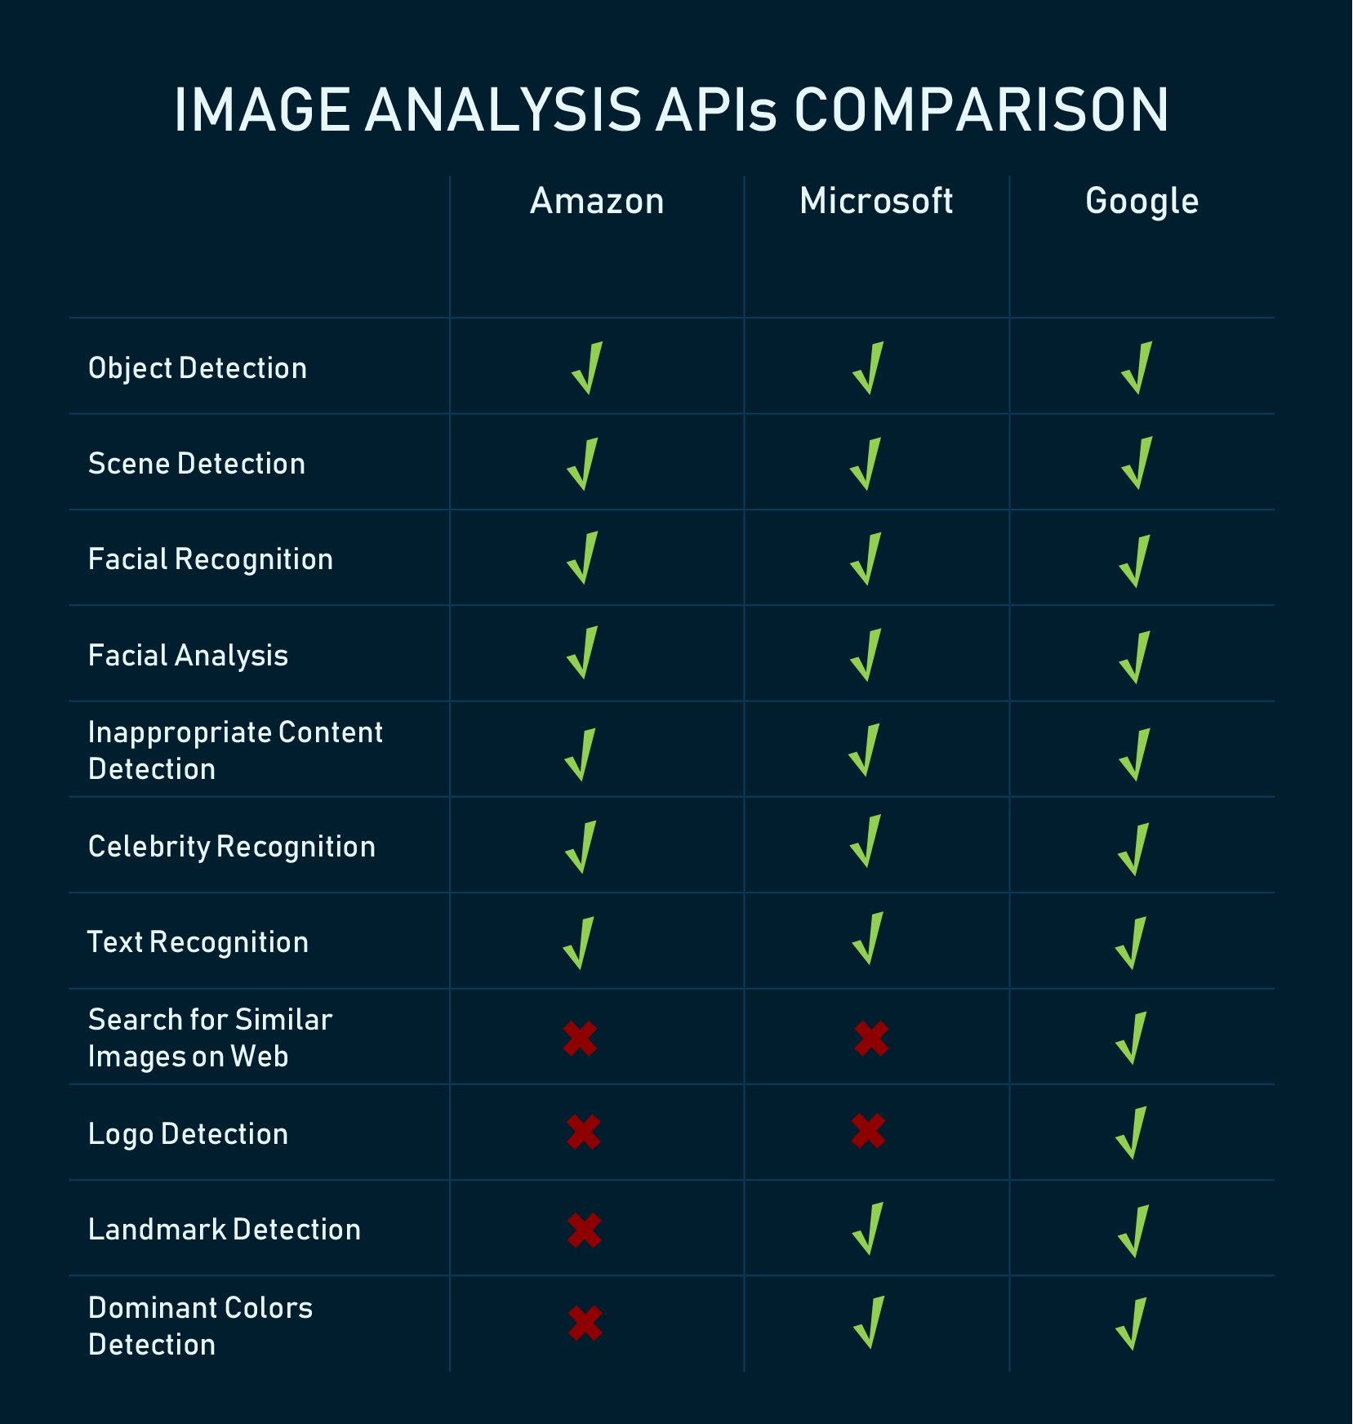
Comparing Azure ML with other MLaS

Slide 49
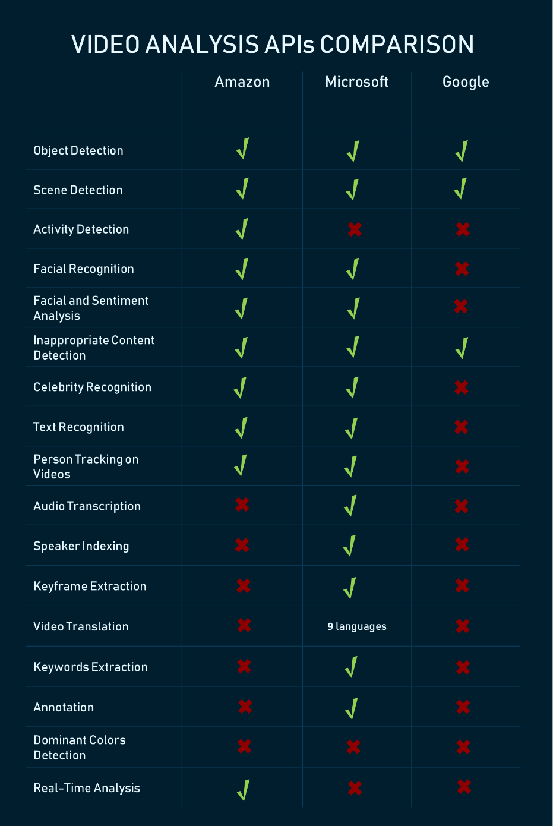
Comparing Azure ML with other MLaS

Slide 50
Azure Machine Learning. Conclusion
Legislative restrictions
International & local
Azure platform restrictions
Max storage volume per account, etc.
Azure ML service restrictions
Data
Max dataset volume: 10 Gb
Vector size limitation: 2^64
Throttled policy
20 concurrent request per endpoint
Max endpoints count: 10K
Black box
No debug
No Scala, C++, C#
No your own right algorithms
Restrictions

Slide 51
Resources
https://docs.microsoft.com/en-us/azure/machine-learning/studio/
https://docs.microsoft.com/en-us/azure/opbuildpdf/machine-learning/studio/toc.pdf?branch=live (documentation as PDF)
https://azure.microsoft.com/en-in/training/learning-paths/azure-ai-developer/ (Video Trainings)
https://msdn.microsoft.com/library/azure/dn906033.aspx (list of all modules)

Slide 52
Q & A

Slide 53
Thank you!

